Slide 1

PREDICTIVE MODELING FOR INSURANCE CLAIM PROBABILITY BASED ON COMPREHENSIVE CAR POLICY FEATURES AND SAFETY RATINGS Project by: Rahul B

Slide 2

Contents:
Problem Statement
Data Preparation
Exploratory Data Analysis (EDA)
Feature Engineering
Modelling
Evaluation
Conclusion

Slide 3
1. Problem Statement
Develop a predictive model that assesses the claim probability for car insurance policies. The objective would be to understand the factors influencing claim frequency and severity in six months and enable insurance companies to better assess risk and determine appropriate premiums for policyholders.

Slide 4
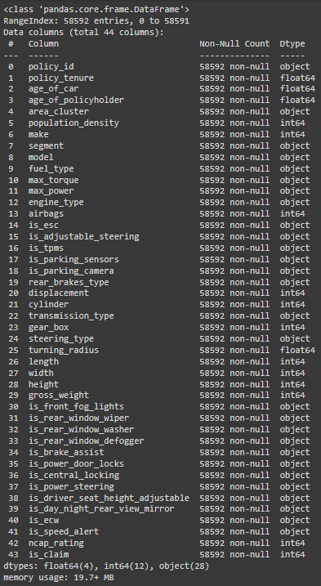
2. Data Preparation
import the dataset using the pandas library pd.read_csv(path/to/file.csv)
Check for null values using df.isna().sum()
Check for duplicate values using df.duplicated().sum()
Transform column df[‘policy_tenure’] data to months by multiplying it by 12.
Transform column df[‘age_of_car’] data to months by multiplying it by 12.
Analysing the age_of_policyholder column, since all values are between 0 and 1, no transformation techniques are applied.
Column policy_id can be dropped for its uniqueness

Slide 5
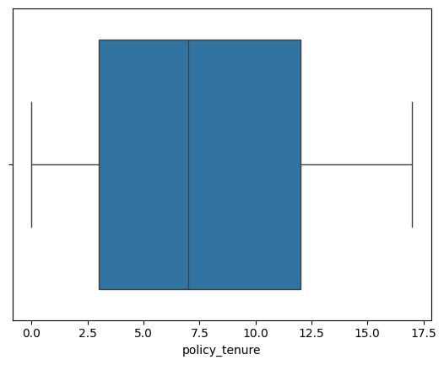
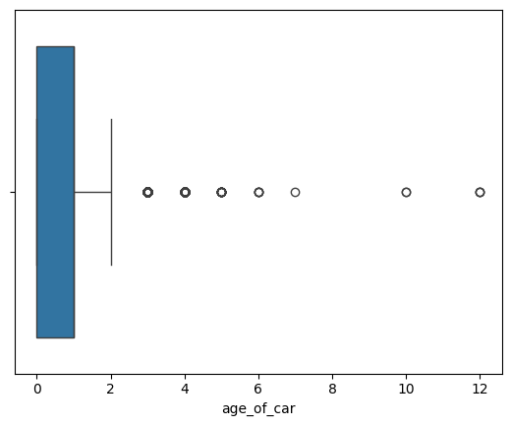
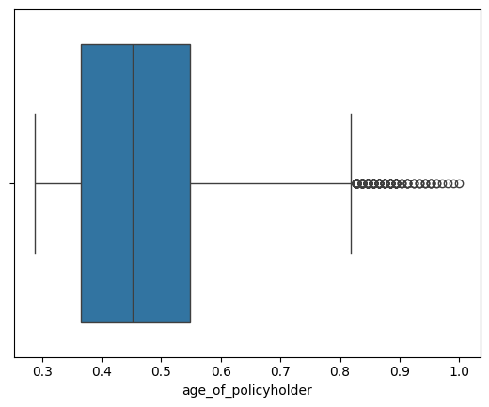
3. EXPLORATORY DATA ANALYSIS (EDA)
WE EXPLORE THE DATA BY UNDERSTANDING ITS MEAN, STD, MIN VALUE, MAX VALUE, AND ITS DISTRIBUTION USING df.describe()
CHECKING FOR OUTLIERS USING BOXPLOTS FOR NUMERIC COLUMNS
for column in df.select_dtypes(include=['int64', 'float64']):
sns.boxplot(x=df[column])
plt.show()

Slide 6
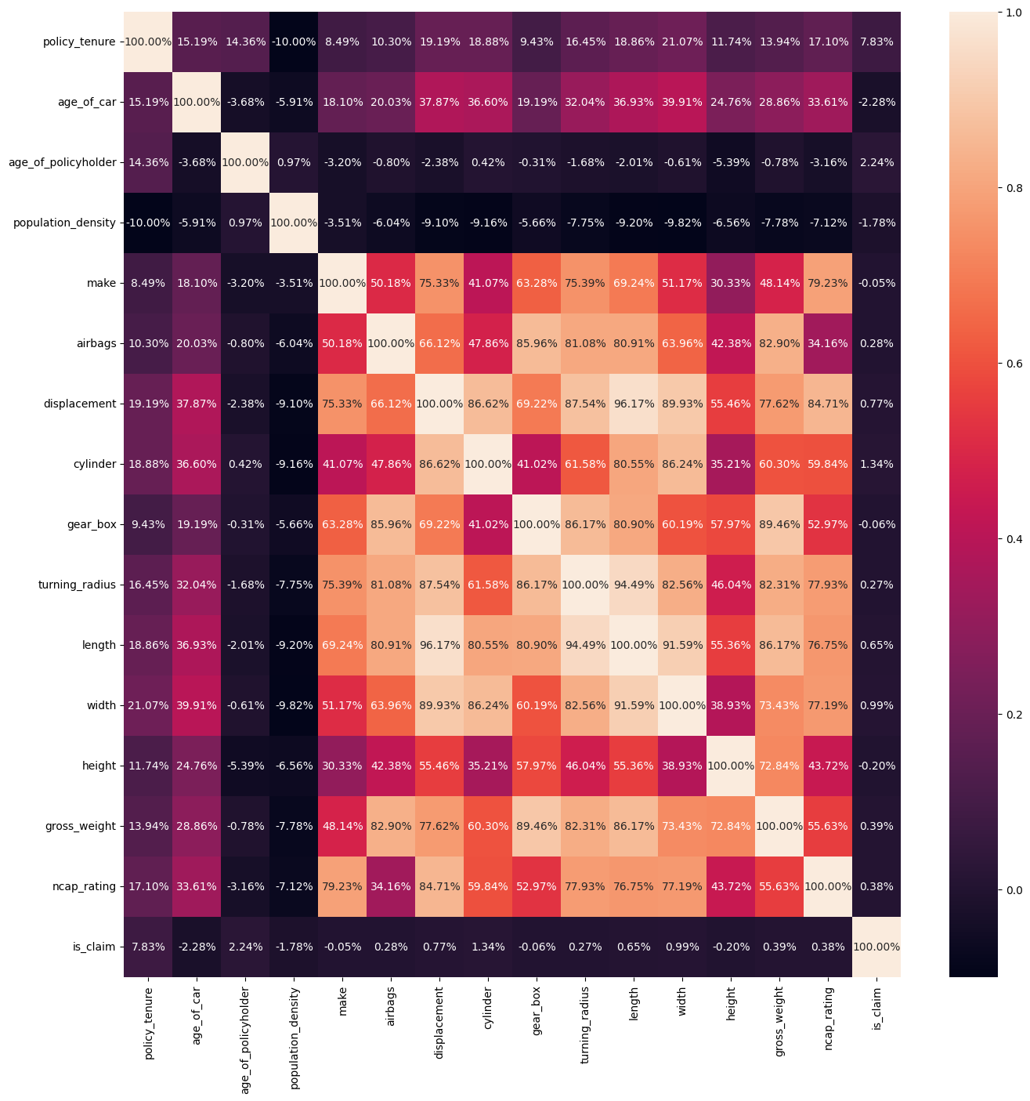

Slide 7
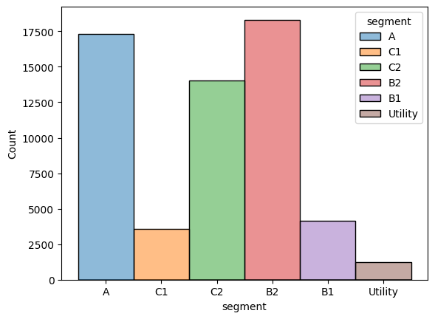
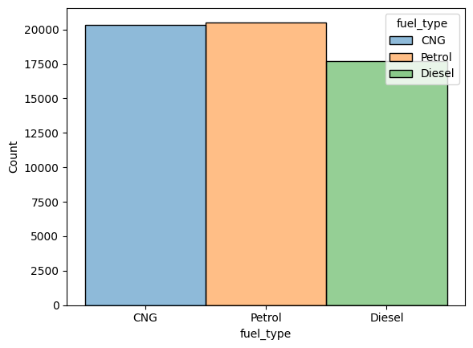
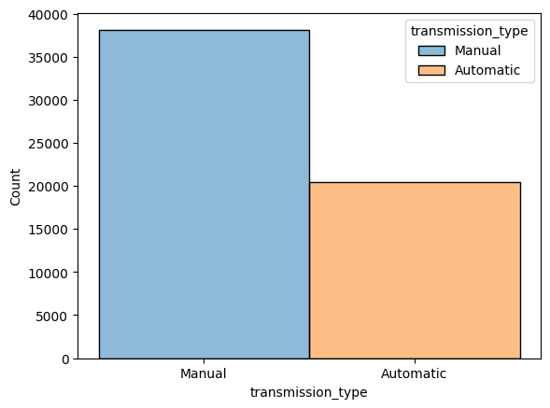
CHECKING FOR OUTLIERS USING HISTOGRAMS FOR CATEGORICAL COLUMNS
for column in df.select_dtypes(include=[‘object’]):
sns.boxplot(x=df[column])
plt.show()

Slide 8
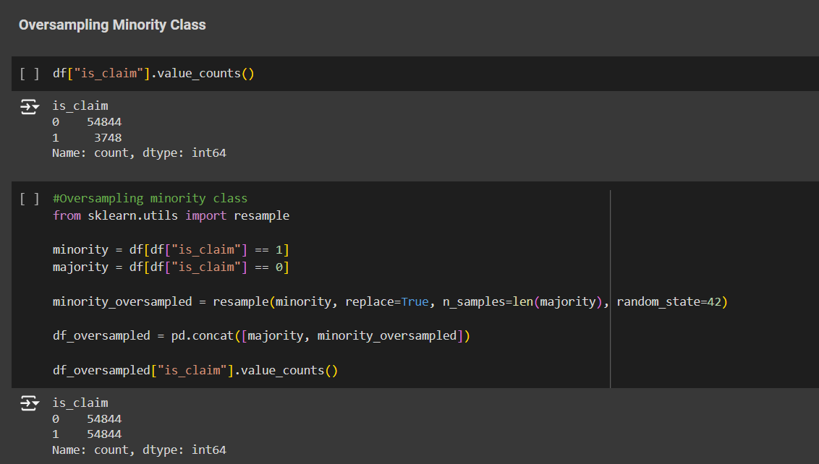
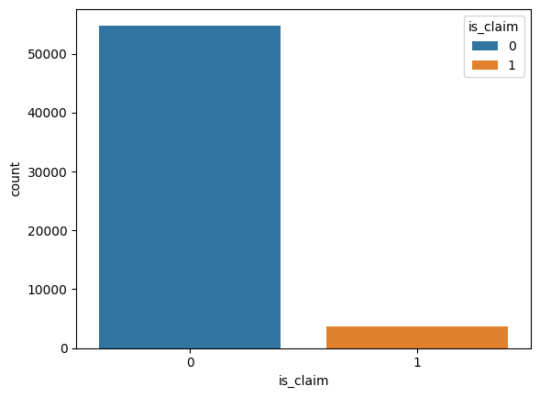
OVERSAMPLING MINORITY CLASS - TARGET VARIABLE (“is_claim”) TO MAINTAIN A NORMAL DISTRIBUTION, AND GIVE ENOUGH DATA FOR OUR MODEL TO UNDERSTAND OUTLIERS, BIAS, AND VARIANCE.

Slide 9
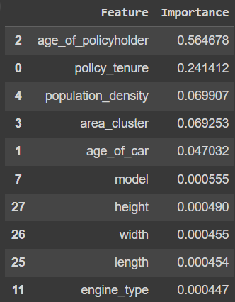
4. FEATURE ENGINEERING
ENCODE CATEGORICAL COLUMN VALUES USING LABELENCODER
USING RANDOMFORESTCLASSIFIER FOR FEATURE EXTRACTION
lab_encoder = LabelEncoder()
encoded_data = df.apply(lambda col: lab_encoder.fit_transform(col) if col.dtype == 'object' else col)
X = encoded_data.drop('is_claim', axis=1)
y = encoded_data['is_claim’]
scaler = StandardScaler()
X_scaled = scaler.fit_transform(X)
rf = RandomForestClassifier(random_state=42)
rf.fit(X_scaled, y)
features_df = pd.DataFrame({'Feature': X.columns, 'Importance': rf.feature_importances_})
features_df = features_df.sort_values(by='Importance', ascending=False)
features_df.head(10)

Slide 10
5. MODELLING
from sklearn.model_selection import GridSearchCV
param_grid = {
'n_estimators': [100, 200, 400],
'max_depth': [10,15,20,25,30,35],
}
rf_model = RandomForestClassifier(random_state=42)
grid_search = GridSearchCV(rf_model, param_grid, cv=5)
grid_search.fit(X_train, y_train)
best_params = grid_search.best_params_ print("Best parameters:", best_params)
THE BEST PARAMS OBTAINED ARE:
n_estimators: 200
max_depth: 30

Slide 11
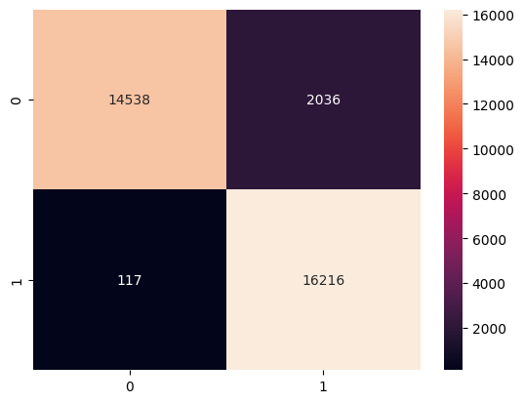
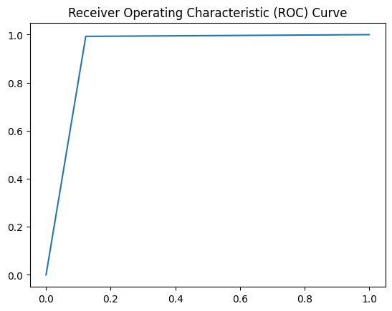
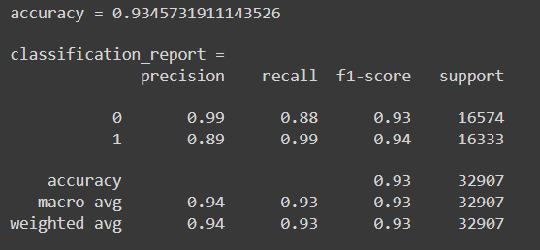
MODELLING WITH ALL FEATURES
6. MODEL EVALUATION
INITIALIZING OUR MODEL WITH BEST PARAMS
RandomForestClassifier(n_estimators=200, max_depth=30, random_state=42)

Slide 12
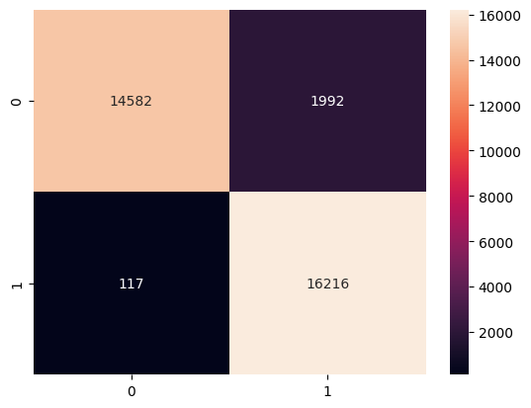

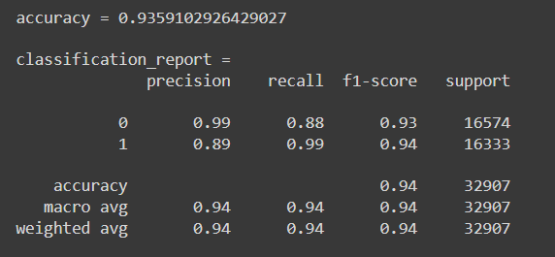
MODELLING WITH SELECTING ONLY THE BEST FEATURES
INITIALIZING OUR MODEL WITH BEST PARAMS
RandomForestClassifier(n_estimators=200, max_depth=30, random_state=42)

Slide 13
7. CONCLUSION
ANALYZING THE TARGET COLUMN AND TREATING THIS AS A CLASSIFICATION PROBLEM
OVERSAMPLING OF MINORITY CLASS WAS NECESSARY TO NORMALIZE THE TARGET COLUMN, OTHERWISE OUR MODEL WAS PRONE TO PREDICTING THE WRONG CLASS.
FEATURE EXTRACTION PLAYS A MAJOR ROLE WHEN THE DATASET HAS MANY COLUMNS AND EXTRACTING THOSE COLUMNS THAT AFFECT THE PERFORMANCE AND ACCURACY OF OUR MODEL BECOMES NECESSARY.
COMPARING THE RESULTS OF BOTH MODELS, THE MODEL WITH THE BEST FEATURES PERFORMED SLIGHTLY BETTER THAN THE OTHER WITH ALL FEATURES
SINCE WE HAVE OVERSAMPLED THE MINORITY CLASS AND TRAINED THE MODEL, IT CAN PERFORM WELL ON ACTUAL DATA CONTAINING BIAS AND VARIANCE WITH 94% ACCURACY.

Slide 14


